Slide 1
Customer Data Discovery
Customer Intelligence
July 6th, 2020

Slide 2
Agenda – Initial Customer Intelligence Discovery
Introduction & objectives – engagement purpose (as-is & to-be data capability assessment, data roadmap and investment sizing)
Confirm Customer Intelligence scope & capabilities – process-centric summarization & platform leverage
End-To-End Data Flows – across customer journey and product/service lifecycle, provide high-level input into upstream, real-time and downstream as-is data domains and pain points
Discuss Future-State Customer “Golden Record” Perspectives – drivers of future customer data model from Customer Intelligence perspective
5 mins
10 mins
25 mins
20 mins

Slide 3
Customer Intelligence Scope
For Discussion
Top-Down Intelligence Gathering
Fundamental Research
Application & Feedback
Market & Competitive Intelligence Gathering
Demographic Intelligence Gathering
Energy Demand/Application/ Use Case Projections
Product & Service Trends
Customer Interaction Trends
Innovation Scans
Third-Party Data
Surveys & Panels
AMI/IoT Based Analysis
Customer Segmentation & Analysis
Product/Service Adoption
Collaborative Research
Segmentation Treatment Development & Testing
Propensity Development & Testing
Customer Behavior Trending & Analysis
Process/Service/Channel Behavior & Analysis
Notes:
Don’t do it just because there is a deadline.

Slide 4
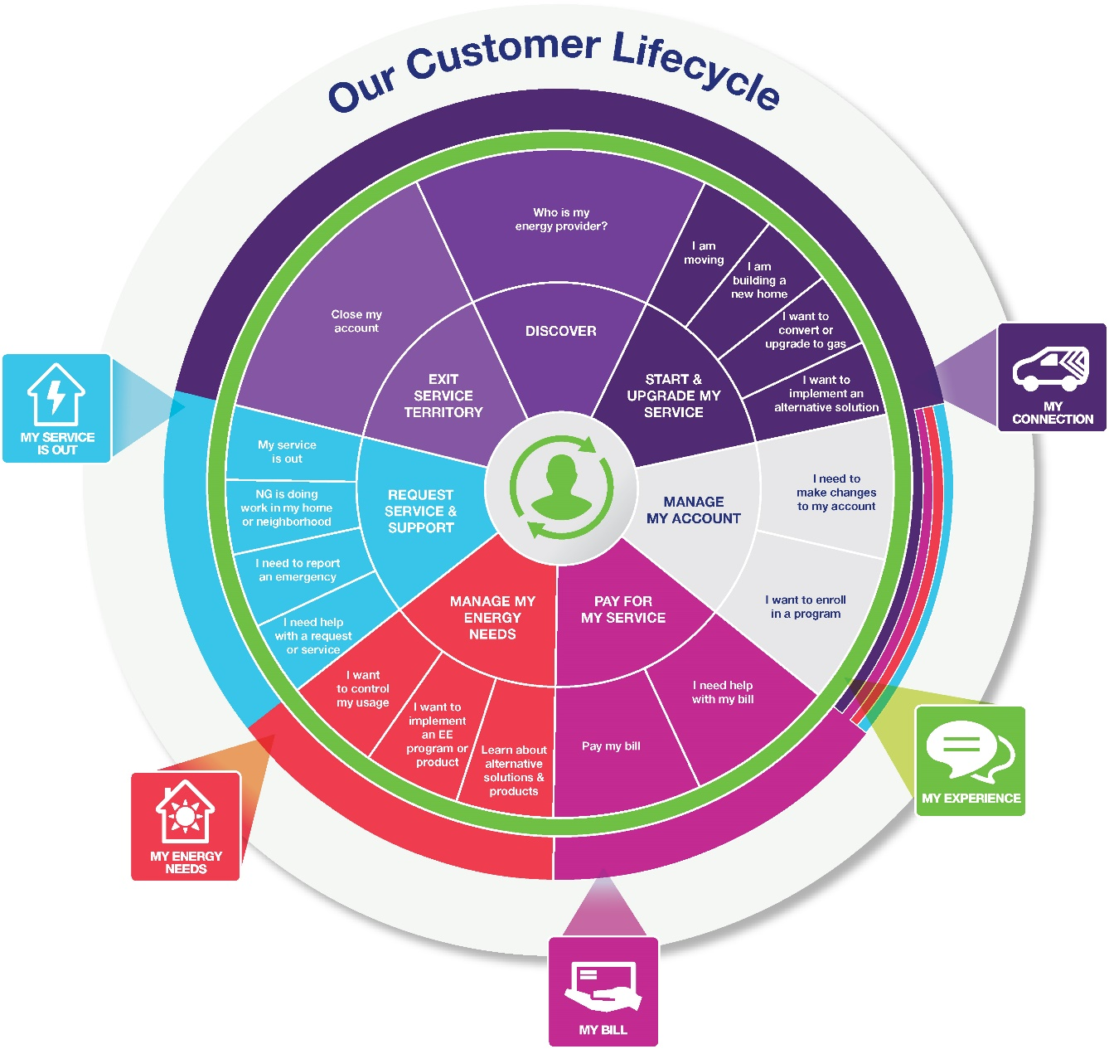
Customer Intelligence – frameworks, boundaries, business partners?
For Discussion
Customer Journey
Product/Service Lifecycle
Marketing & Communications
Customer Experience Products
Channel Planning & Improvement
Social Engagement
Customer Performance & Assurance
Marketing & Communications
Product Groups: New Connections, EE, EV, DG, DR, Customer Experience Products
Customer Operations & Business Services: Preferences, Credit & Collections
Potential Boundaries
Notes:
Don’t do it just because there is a deadline.

Slide 5


Information Flow Analysis – where does Customer Intelligence play?
Products/
Services
Contact /
Customer
Profile /
Preferences
Lead /
Opportunity
Location
(Premise)
Case
(e.g. Application/
Work Order
Complaint)
Customer
/ Account
Asset
(e.g. Meter /
Product
Thermostat)
Usage
(Meter
Reading)
Bill /
Payment
GL
Account
Data Domain
Market / Sales
Market / Sales
Market / Sales
Service
Service
3
Service
Asset
Asset
Bill/Pay
Finance
Need to align with Electric and Gas Ops Flows
Need to align with Electric and Gas Ops Flows
CSS Transaction Web
1
CRIS Transaction Web
Need to end to end process for Lead/Opportunity for all products
Application Portal (DG/Electric)
Need to add metering systems for input into CIS systems
Marketplaces (EE/EV Products)
2a
Need details Marketplace - Reimbursements for LC&I, Small Business and Trade Partners via DSM. Manual and Automated Flows
Questline / MC (Marketing Comm)
2b
Kubra (Outage Comms)
email
Right Now
CRM Sales (Grid Force)
In-Demand (DSM/EE Program Mgt.)
Applications
CRIS (Gas –NYC,MA)
CSS (Gas, Elec, DG)–UNY,MA,RI,LI)
CRM Service (GBE-RI)
MITS (CSS) / SPIPE / DIS (CRIS)
GIS
Maximo / MDSI
Need to find more details about CRIS GIS Feed
Storms / Mwork / MDSI (LI)
OMS (Outage)
SAP ECC6
CEMP 3rd Party (Uplight / O-Power)
4
CIAP
Customer
Data Platforms
ADA
CDI
CCAE
CSS (Revenue) Data Warehouse
CSQ / Trends
Automated API
Automated Replication
Single data master agreed
No Explicit Master / Implied
Data mastered in multiple applications
(This includes across all Jurisdictions)
DB Link
Manual replication
Notes:
Don’t do it just because there is a deadline.

Slide 6
Master Data Flows
Customer Intelligence Perspectives
CIAP Dimensions & Structure – sufficient to support CI function?
ADA Dimensions & Structure – is this for focused load research?
Other Key Sources (i.e. InDemand, Portals/Web, Credit/Collections) Not Yet Integrated) – what is missiong?
Conflicting Dimensions & Structures – what internal conflicts does CIAP have?

Slide 7
Transactional Flows – Customer Intelligence responsibility?
Inbound Data – what transactional-level or customer/household data does Customer Intelligence responsible for procuring, importing, associating:
Third-Party Data
Other Fundamental Research
Vendor Data
Other Data
Analytical & Campaign Data (Internal Use) – what customer/household/account data is moved to/from CIAP to support:
Statistical Analytics
Segmentation/Clustering/Propensity
Campaign Platforms
Preference Platforms
Other Data Marts
Outbound Transactional Data – what customer/household data is forwarded to third-parties as part of go-to-market commitments? Who creates/extracts/manages these flows?
Vendors
Research/Survey/Panel Providers
Other Trade Allies

Slide 8
Data Flows
Live Discussion
Customer Intelligence
Pain Points
Upstream Data
Transactional Data
Downstream Data
?
Notes:
Don’t do it just because there is a deadline.

Slide 9
Notes
Live Discussion
?
Notes:
Don’t do it just because there is a deadline.

